Slide 1
Report
May-2023 MP Inspection BFX – UA300
Date : 07-Aug-2023
Prepared by: Rachel Ruan

Slide 2
Issue Description
23-Jun, ALT customer complain [BFX-UA300] May – 2023 Mass production issue.
Overall inspection result => Conditional Pass (Waived)
Defect Total:
Critical
• Unstable operation (hang up / no boot) * 3pcs
Major
• Side LED – R is different color * 1pcs
• Screw inside * 1pcs

Slide 3
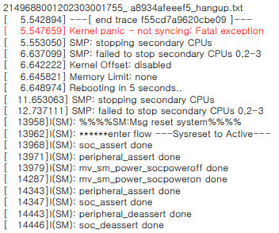
1. Unstable operation (hang up / no boot)
Issue Description | FA | Root cause | Actions | Status
Symptom: Unstable operation (hangup / no boot) Type: Critical Defect unit Q’ty : 3/315pcs Defect rate : 0.95% SKB SN: 2149695001202303001760, 2149695001202303001774, 2149695001202303001755 | ALT initial review • Visual check : No found abnormal. • Function check : found abnormal – No boot or hang up • As a Hang up log, kernel panic is occurring 1. Check FATP data → Product test pass normally 2. Suggestion - Use oscilloscope to measure crystal frequency (Y2: 25MHz) generate CLK pulse for Soc_U1 - Measure voltage: U68(1.05V), U69(1.05V), U64(2.5V), U1312(1.2V), U1310(3.3V), U1311(1.8V), U1308(5V) | Waiting PE analysis ( Due date : 10-Aug.2023) | 1. Update new process on FATP (after RC1): Check status product ON/OFF 5 times(ON:5mins OFF:30s). 2. Waiting analysis result will update more action form factory , cover

Slide 4
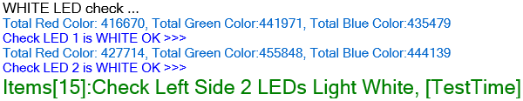
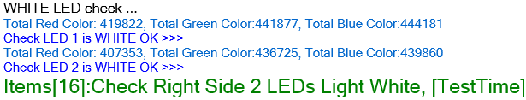
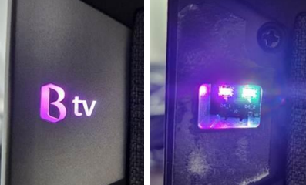
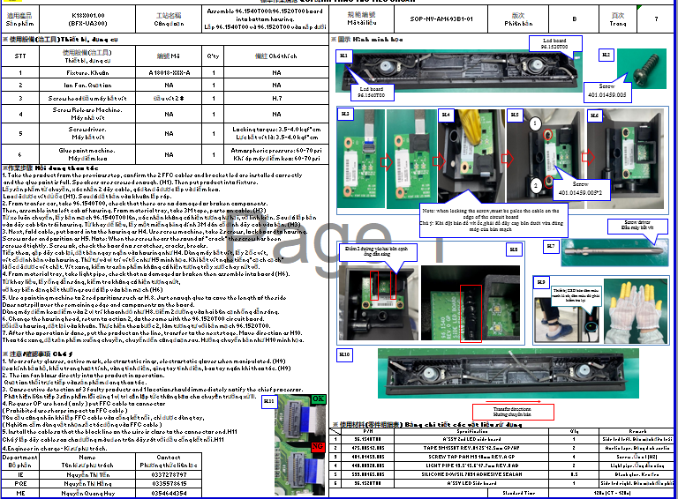
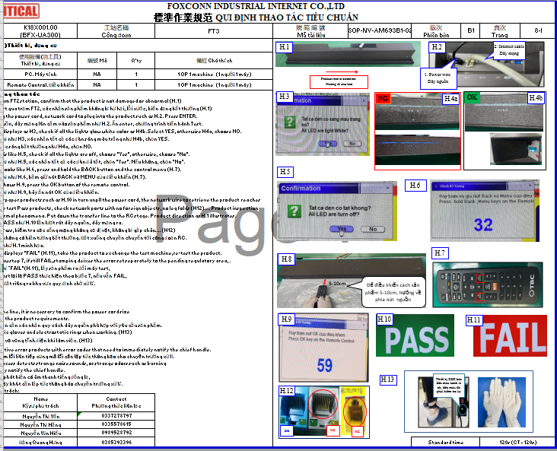
2. Side LED – R is different color
Issue Description | Root cause | Actions | Status
Symptom: Side LED – R is different color Type: Critical Defect unit Q’ty : 1/315pcs Defect rate : 0.31% SKB SN: 2149695001202303001179 | 1. Check FATP data SN ➔ Test recode had Fail R-FT2 cause fail speaker ( WAL580) no related LED issue. 2. Check test-Log of the station FT1 and FT3 ➔ PASS normal 3. The station FT1 ( Check LED by test program – machine ) and FT3 ( manual check by OP-eye ) have check LED light and LED color, But maybe due disassembly housing can make loose plug FFC cable. 4. Maybe OP operation due disassembly the cable hasn’t fully inserted. When we test function this unit FFC cable connect unstable make pass check LED function. | 1. Re-training OP doing and rework follow SOP define. Status : Done 2. Online verify 10 units had rework after disassembly housing, test FT1 and FT3 , check LED all is normal . Status : Done 3. OBA test function more product disassembly housing before packing. Status : Done

Slide 5
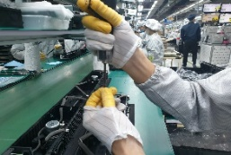
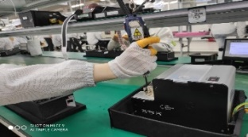
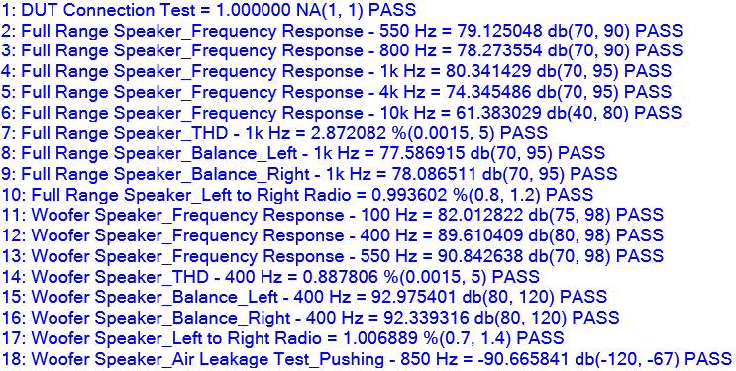
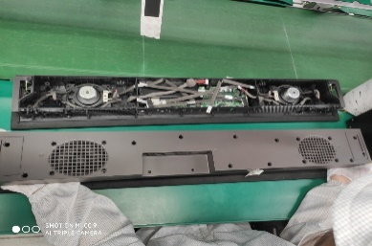
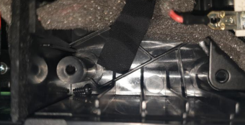
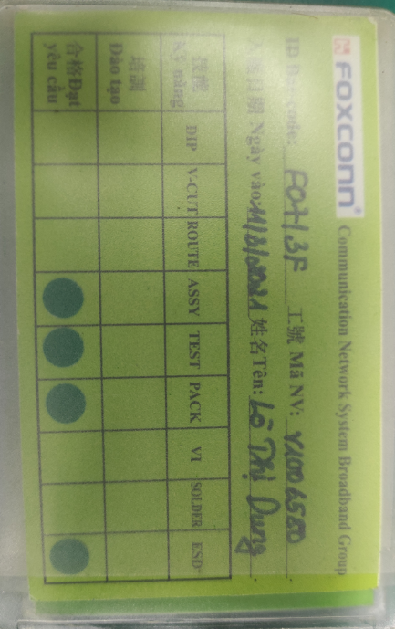
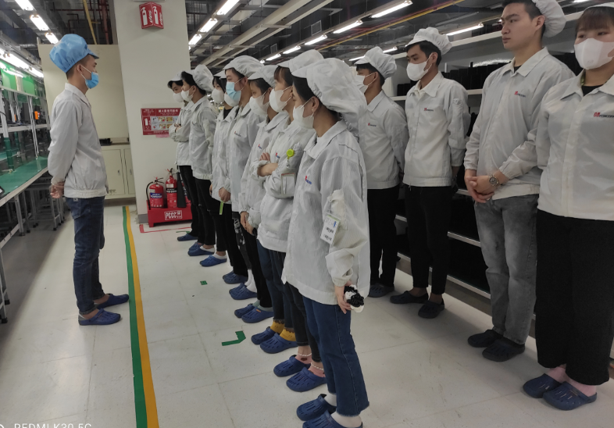
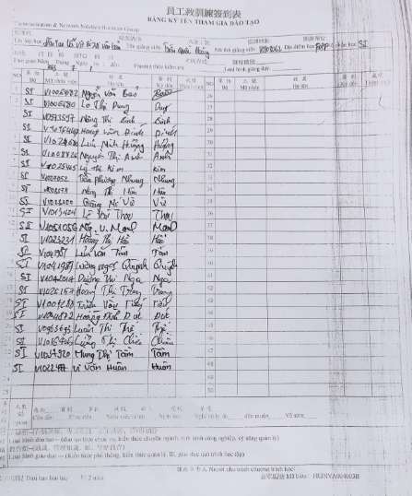
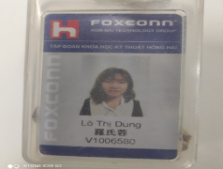
3. Screw inside
Issue Description | Root cause | Actions | Status
Symptom: Screw inside Type: Major Defect unit Q’ty : 1/315pcs Defect rate : 0.31% SKB SN: 2149695001202303002967 | 1. Check this units speaker test result: 18 items test speaker all PASS. 2. This station maybe OP use hand take screw out machine drop inside product, OP no upside down product before final Top case housing. ( SOP define it ) 2. V1006580 Lò Thị Dung. Line K2. | 1. Doing follow SOP ( SOP define take screw by machine, not by hand). Status : Done 2. Request each OP doing must have self check, re-check and final check. Status : Done 3. Before run line , line leader training OP, notice quality online issue, IPQC defect issue, OBA issue, read SOP and quality alarm. Status : Done
NG
OK

